Slide 1


SAFE MONEY FOR EVERYONE

Slide 2
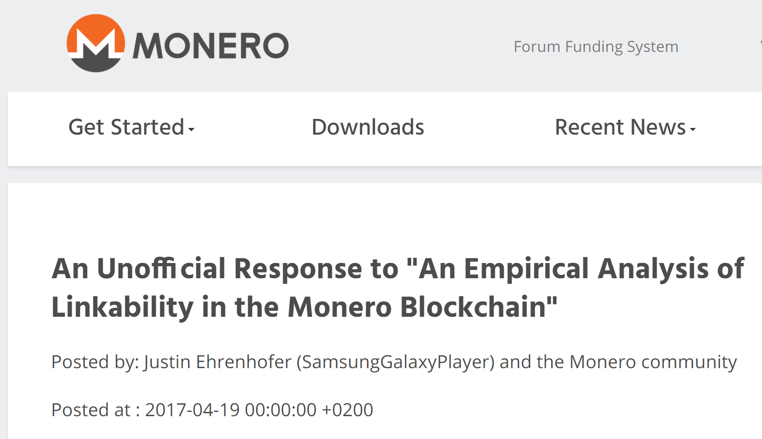
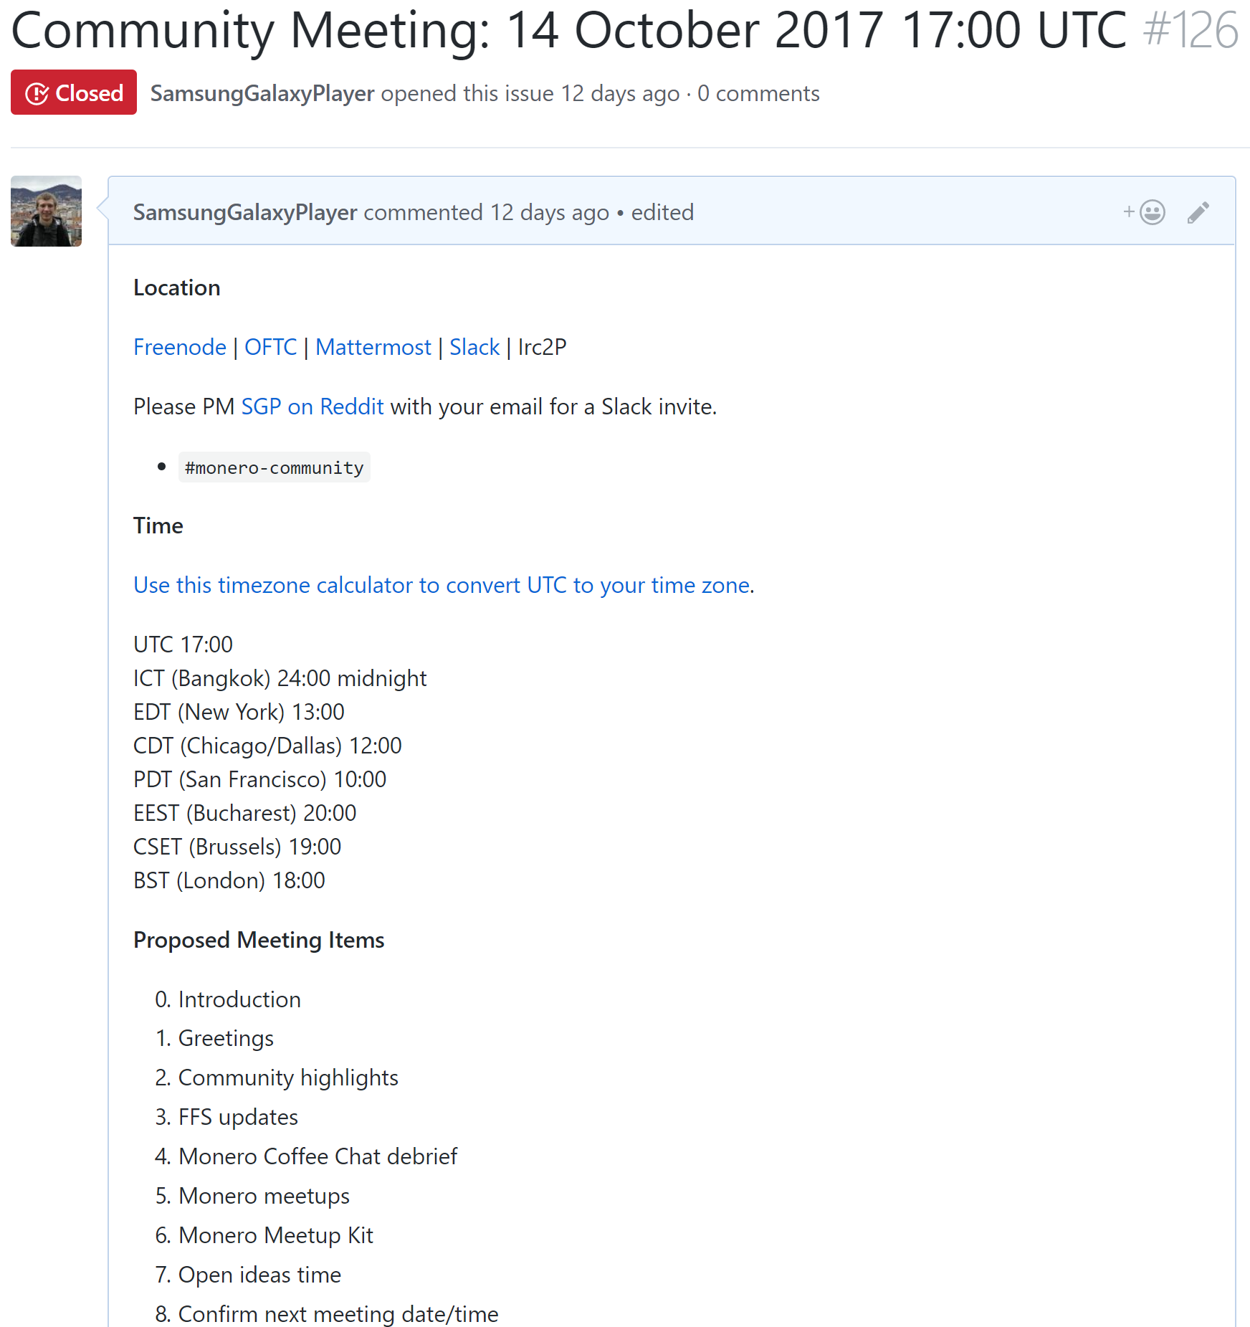
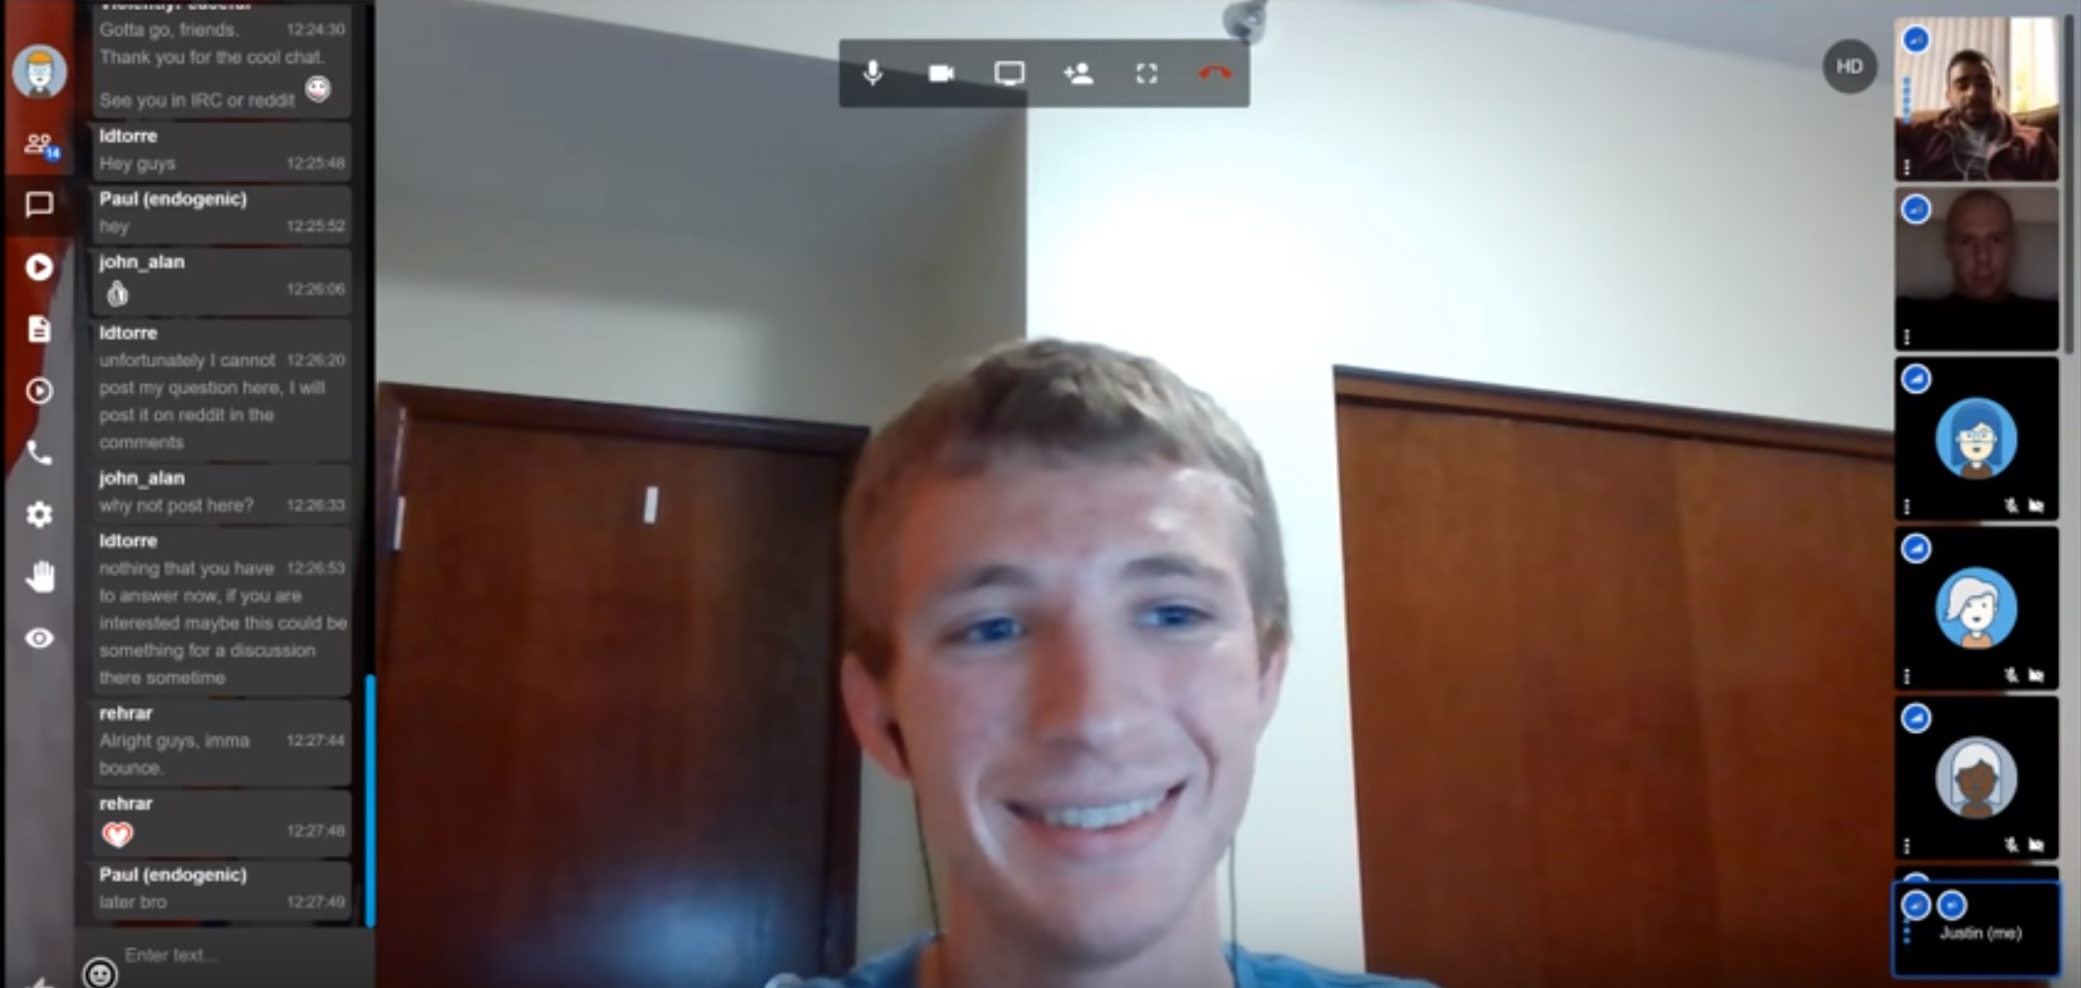
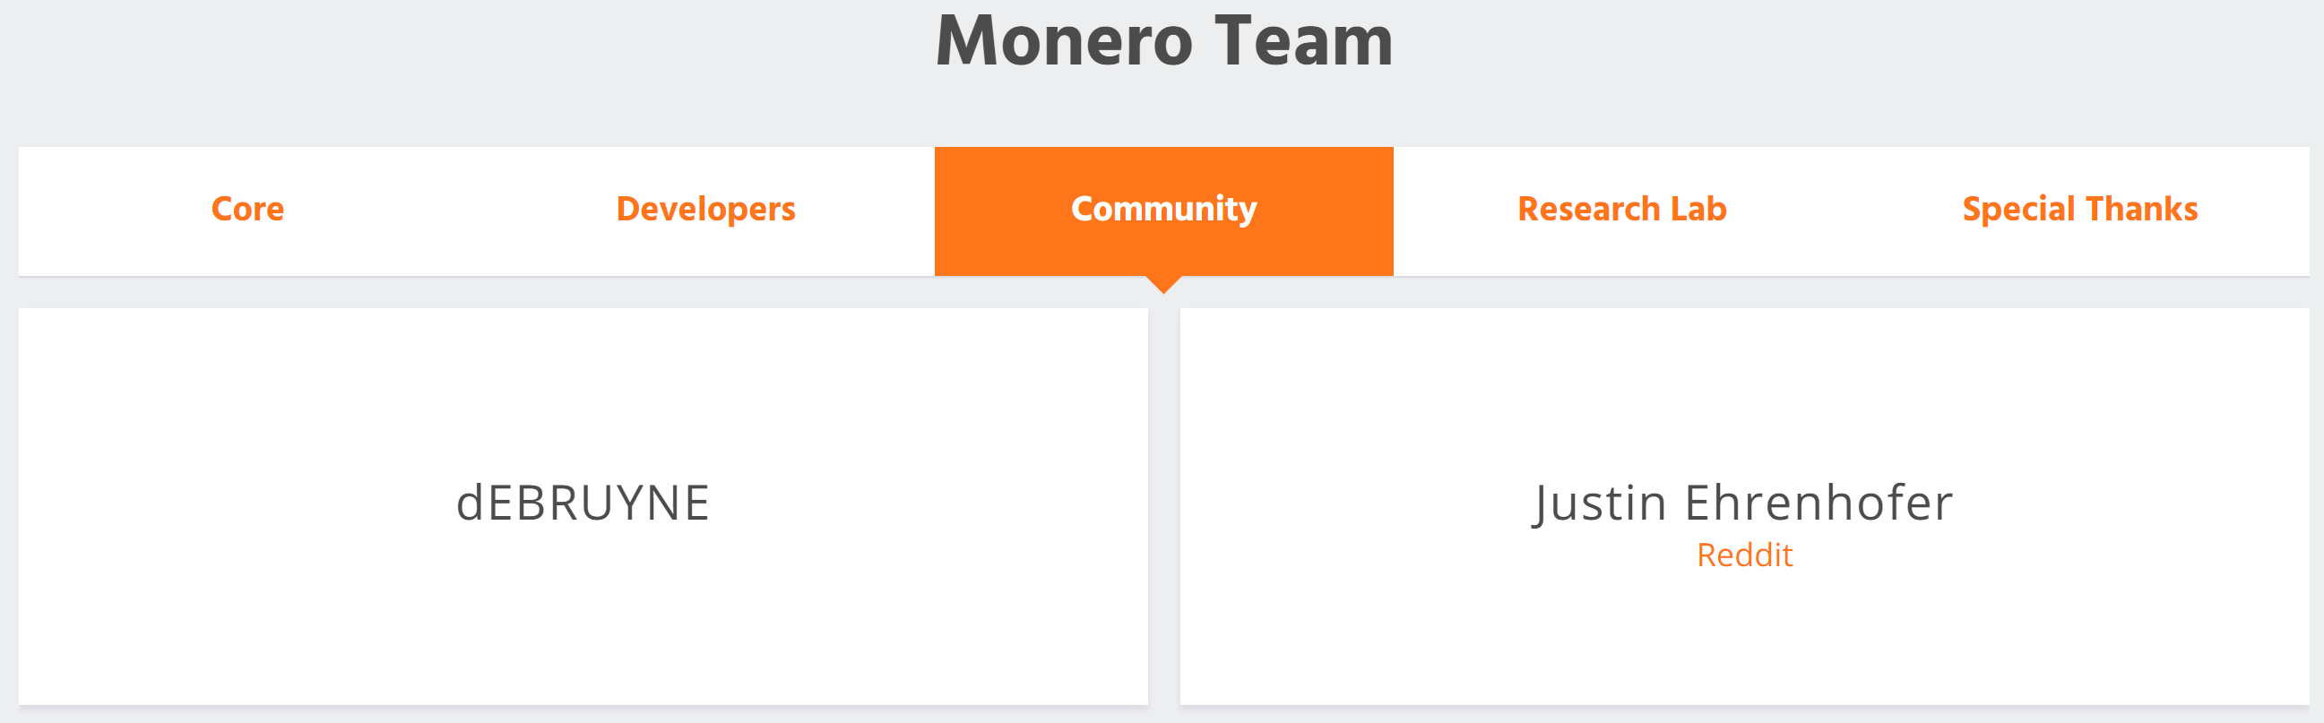

Slide 3
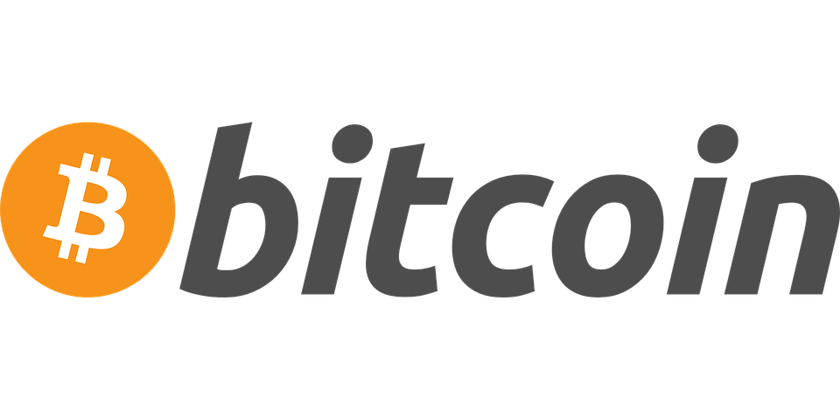
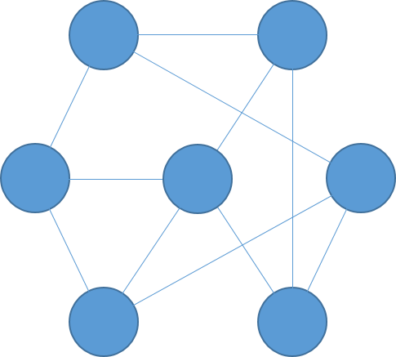
DECENTRALIZED
Older
Newer
BLOCK
Tx ID: wgis85cissajr5da7wz3fcnqnhift
Sender: w3fn5ujfm3d3r975qjd35jrwd4k5q
Receiver: nftic5k8sf4j598wf357jw38956659
Amount: 10 BTC
Notes:
In simple terms, Bitcoin is a decentralized network, where a history of the transactions is stored on thousands of computers around the world. This history is called the blockchain. The blockchain is a chain of blocks. Each block contains the most recent transaction history. There is a new block every 10 minutes. People will ask miners to include their transactions in the next block, often with a fee. The network automatically adjusts so that a new block can be added by one miner at random approximately every 10 minutes. Once a transaction is included in a block, it has a confirmation. People who are very cautious wait for several confirmations, since it is significantly harder to reverse an old transaction than a new one.

Slide 4
Bob
Alice
0.1 BTC
w3fn5ujfm3d3r975qjd35jrwd4k5q
nftic5k8sf4j598wf357jw38956659

Slide 5
Bob
Alice
0.1 BTC
w3fn5ujfm3d3r975qjd35jrwd4k5q
nftic5k8sf4j598wf357jw38956659

Slide 6
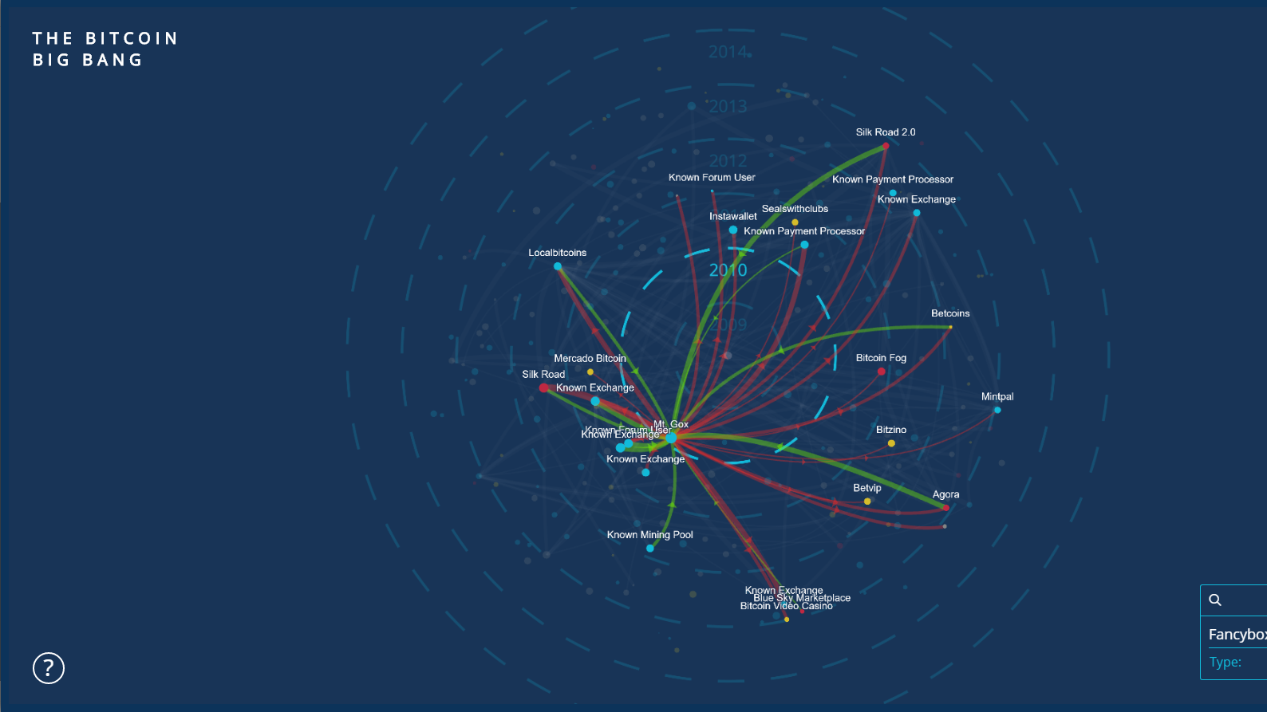

Bitcoin is NOT private!
Notes:
Bitcoin is not private! In fact, it is perhaps the most transparent money system ever made. Everyone in the world can see a history of the following:
The amount of money in a wallet
Where the Bitcoin came from
Where the Bitcoin went
This visualization shows the transfer of Bitcoin from large accounts to others. It is a visual representation of transfers of Bitcoin.

Slide 7
Why Privacy Matters

Slide 8




People Started Adding Tools to Bitcoin
Notes:
When people started realizing that Bitcoin is not private, they tried adding things on top of Bitcoin so some people could have privacy. This is traditionally done with a Bitcoin mixing or CoinJoin approach. Several people take their Bitcoin and send it to a centralized server. This centralized server then gives a random Bitcoin from among those received back to the users. Ideally, this could provide some untraceability, since the origin of the received funds is ambiguous. However, there are several fundamental issues with this type of approach.

Slide 9
People Started Adding Tools to Bitcoin
Notes:
The vast majority of people who use an optional system that costs extra which you need to go out of your way to use are people who have tainted coins. Tainted coins are coins that are known to previously be used for illicit purposes. An insignificant number of people pay money to mix clean coins. Thus, mixers do not work very well at providing plausible deniability. Instead, they make you stand out, since it makes it look like you are doing something wrong. Mixing itself is a shady act.

Slide 10
People Started Adding Tools to Bitcoin
Notes:
Second, you add a level of trust to the system. While Bitcoin is trustless, you need to trust the mixer you use with CoinJoin. They may choose to keep a history of the transaction information, and the people who use the service will never know. People must trust that the mixer does not act maliciously, which is a systemic risk with mixing services. In an ideal private system, you should not have to trust anyone else with your privacy.
Finally, from a convenience perspective, it takes a long time to mix coins, since you need to wait for other participants to mix with. If you plan to mix a large number of coins several times, it can take days or weeks. Few users will go through this effort.

Slide 11
The Monero Difference
SENDER
AMOUNT
TRANSACTION
BROADCAST
RECEIVER
ɱ
RING
SIGNATURES
RING CONFIDENTIAL
TRANSACTIONS (RINGCT)
KOVRI
(I2P ROUTER)
STEALTH
ADDRESSES
Notes:
Monero is different from a mixing service. It uses three technologies and a work-in-progress fourth technology to provide trustless privacy for all transactions. These technologies work together to protect different parts of a transaction. The sender is hidden with ring signatures. The amount is hidden with ring confidential transactions, or RingCT. The transaction broadcast is not currently hidden without extra steps, but Monero is working on Kovri, an I2P router, to hide this with no additional effort. The receiver is hidden with stealth addresses. All of these technologies will be addressed in this presentation.

Slide 12
Ring Signatures & RingCT
8 (Tx ID hng6iwfumwf8)
8 (Tx ID hng6iwfumwf8)
15 (Tx ID wn3f4diiijffwn)
1 (Tx ID e4hn4ifqyd5ed)
15 (Tx ID wn3f4diiijffwn)
2 (Tx ID eshgni5lsvnf74)
9 (Tx ID cb8vqfi8dfj65f)
16 (Tx ID 5 f8wnfdmmii)
3 (Tx ID wb4f5hdfdicnd)
10 (Tx ID fnidmfnu3dm8)
17 (Tx ID h8fn5mdfi4w)
4 (Tx ID nh5nogsefwjw)
11 (Tx ID twv8mf8dnfas)
11 (Tx ID twv8mf8dnfas)
18 (Tx ID n48gfwmfdki)
BLOCKCHAIN
18 (Tx ID n48gfwmfdki)
5 (Tx ID fgwinw3fwtk54)
5 (Tx ID fgwinw3fwtk54)
12 (Tx ID h5o8mfdngkd)
19 (Tx ID fnidmnfdsam)
6 (Tx ID ybwnng8nengf)
13 (Tx ID 7nr8mrjffijdtm)
20 (Tx ID t4vn8lf8djer4)
7 (Tx ID e4bgn8flwwrj8)
14 (Tx ID f8n8madkrjmd)
21 (Tx ID 4f5f8njdoam4)
21 (Tx ID 4f5f8njdoam4)
Notes:
Start by imagining the entire money supply of Euros or Dollars, all in one place. This supply is divided into different notes or bills of a certain value (10, 20, 50. etc). Monero is basically the same. The whole Monero money supply is contained in different outputs, each with a certain amount of Monero. One could be 0.01 XMR, and another could be 1000 XMR. Now imagine this red highlighted one is an output that you control. You have the ability to spend it, and it’s as if you had physical money in your wallet. When you make a Monero transaction, you want to hide what the origin of the funds are, since Monero tries to prevent the blacklisting of certain coins. Your wallet software will select other inputs from those available. These will be controlled by other people. You will appear to spend these amounts, along with your own, even without communicating with the real owner. Thus, by making it seem as if your red input is spent along with the other blue ones highlighted here, no one but you (the sender) knows what the origin of the money is.

Slide 13
Ring Signatures & RingCT
INPUTS
5 (Tx ID fgwinw3fwtk54)
8 (Tx ID hng6iwfumwf8)
11 (Tx ID twv8mf8dnfas)
Ringsize = 6
Minimum Ringsize Allowed
15 (Tx ID wn3f4diiijffwn)
18 (Tx ID n48gfwmfdki)
21 (Tx ID 4f5f8njdoam4)
key image
Notes:
The ring signature is just the process of taking your red (real) input, the blue ones (decoys), and making it seem as if they are all spent simultaneously. An outside observer does not know which is the real one, since they are all possible. In this example, the ringsize is 6, meaning that 6 total inputs (including your own) are used. As of August 2017, the minimum allowed by the network is 3. In September 2017, the minimum is expected to be increased to 5 or greater, since more decoys allows for better privacy. The key image is generated for the real input used. Nodes and miners can use this to verify that a real input is actually being spent, but they still do not know which input is real. The key image prevents attackers from spending money more than once or from spending money that does not exist.

Slide 14
Ring Signatures & RingCT
Pedersen commitment
rCT = x*G + a*H(G)
INPUTS
Random Number
Actual Amount
5 (Tx ID fgwinw3fwtk54)
5 (Tx ID fgwinw3fwtk54)
8 (Tx ID hng6iwfumwf8)
8 (Tx ID hng6iwfumwf8)
RingCT ring signature, signs difference between commitments
11 (Tx ID twv8mf8dnfas)
11 (Tx ID twv8mf8dnfas)
Ringsize = 6
15 (Tx ID wn3f4diiijffwn)
Minimum Ringsize Allowed
15 (Tx ID wn3f4diiijffwn)
? XMR
18 (Tx ID n48gfwmfdki)
18 (Tx ID n48gfwmfdki)
Commitment public key
21 (Tx ID 4f5f8njdoam4)
21 (Tx ID 4f5f8njdoam4)
key image
Notes:
For each of these inputs, a fraction is used according to a Pedersen commitment. It is not important to remember any important math on an introductory level, but know that the sender in a transaction spends a proportion of the input that only the sender knows. The commitment itself consists of two parts: 1) the actual amount a, which is hidden by adding 2) a random number x. Since no one knows what the random number is except the sender, an outside observer does not know how much is actually being spent. This commitment will be evaluated among the inputs and outputs, to make sure the same value is generated on both sides of the transaction. A range proof prevents the sender from using a different random number for the input and output set. Finally, the transaction is fully signed as a RingCT ring signature, resulting in an unknown amount of Monero sent to the receiver or receivers. As an output, the commitment public key is published to allow the network to audit the math done behind the Pedersen commitment.

Slide 15
Ring Signatures & RingCT
INPUTS
5
A to B
B to C
C to D
8
Older
Newer
11
15
18
Input previously seen in this transaction, but unsure if actually
used as sent money or if used as a decoy in a ring signature.
21
Notes:
Now that we have looked into how the inputs for a single transaction are hidden among others, it can be helpful to look at how inputs are used over time. The same inputs as before are on the left. The history for the red one is shown on a hypothetical blockchain on the right. The older blocks are on the left, and the newer blocks are on the right. The blocks highlighted red signify to the times that this input was included. There are three ways this could happen:
It is new money from a Coinbase transaction. This is known to everyone on the network. They do not know what address controls it.
The input was actually spent by the real controller
The input was borrowed an used as a decoy in another transaction
Since there is no way to differentiate between 2 and 3, there is no way of knowing whether an input is actually spent, even if it appears in a specific block.

Slide 16
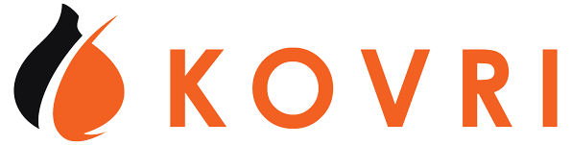
12.154.85.166
ORIGIN
NODE
Tx ID: 375wd4h
LOGGING
NODE
Notes:
When you tell the network that you would like for them to include your transaction in the next block, you can leak some very important information about yourself, even if the transaction itself is obfuscated. Some nodes on the network may be logging the IP address that they receive these requests from. Fortunately, it is very difficult for an attacker to know that this is the real origin of the transaction, but they can still make an educated guess. Then, they could knock on your door and demand your private key. Not good. Or perhaps an ISP could say they purposefully block connection to the Monero network. Not good either. Kovri will allow people to hide their IP address and, optionally, hide from one’s ISP that Monero is even being used at all. This is done by tunneling connections though the I2P network. I2P is similar to Tor with a few important differences. Every node is a participant on the network, which allows Monero to contribute to I2P rather than just mostly leeching off Tor. In any case, Kovri will allow users to protect their connection information locally and from outside attackers.

Slide 17
j3hdkil4juppzdz2z3hiybauoagcq4rz3lcqygge5tmg2ea7vs3q.b32.i2p
ORIGIN
NODE
Tx ID: 375wd4h
LOGGING
NODE
Notes:
Instead of an attacker getting one’s real IP address, they would instead get a meaningless, disposable I2P address. We cannot prevent nodes from logging or even know which nodes log, but we can give nodes garbage information. That’s what Kovri does.

Slide 18
Stealth Addresses
INPUTS
OUTPUTS
Commitment public key
Back to Sender
ey5f8ne58nh5nogsefwjw
? XMR
58fmd8jhybwnng8nengf
To Receiver
Notes:
Finally, Monero hides where the money is going to with stealth addresses. Instead of sending money directly to an address, Monero is essentially locked in a container. Every account must search each of these containers to know which is for them, but only one account can open the container. Furthermore, no one else knows who the container is for. This is how stealth addresses work on a very basic level. Outside observers don’t even know these outputs from a single transaction go to one person. They could go to several people. In this example, the red ones go to the receiver, and the blue ones come back to the sender as change. This change can be used to break up large inputs (say they have 100 XMR but only want to send 10 XMR to someone. Then, they can send 90 XMR back as change).

Slide 19
Summary
5 (Tx ID fgwinw3fwtk54)
8 (Tx ID hng6iwfumwf8)
5hfnq835hng6iwfumwf8
11 (Tx ID twv8mf8dnfas)
? XMR
3348dqnqcb8vqfi8dfj65f
15 (Tx ID wn3f4diiijffwn)
Commitment public key
18 (Tx ID n48gfwmfdki)
21 (Tx ID 4f5f8njdoam4)
Notes:
In summary, for any given transaction, Monero is sent from an ambiguous source, from which an unknown amount is committed and thus an unknown amount is sent, to an unknown receiver or set of receivers. As you can see, all information stored on the blockchain is obfuscated by mandate.

Slide 20
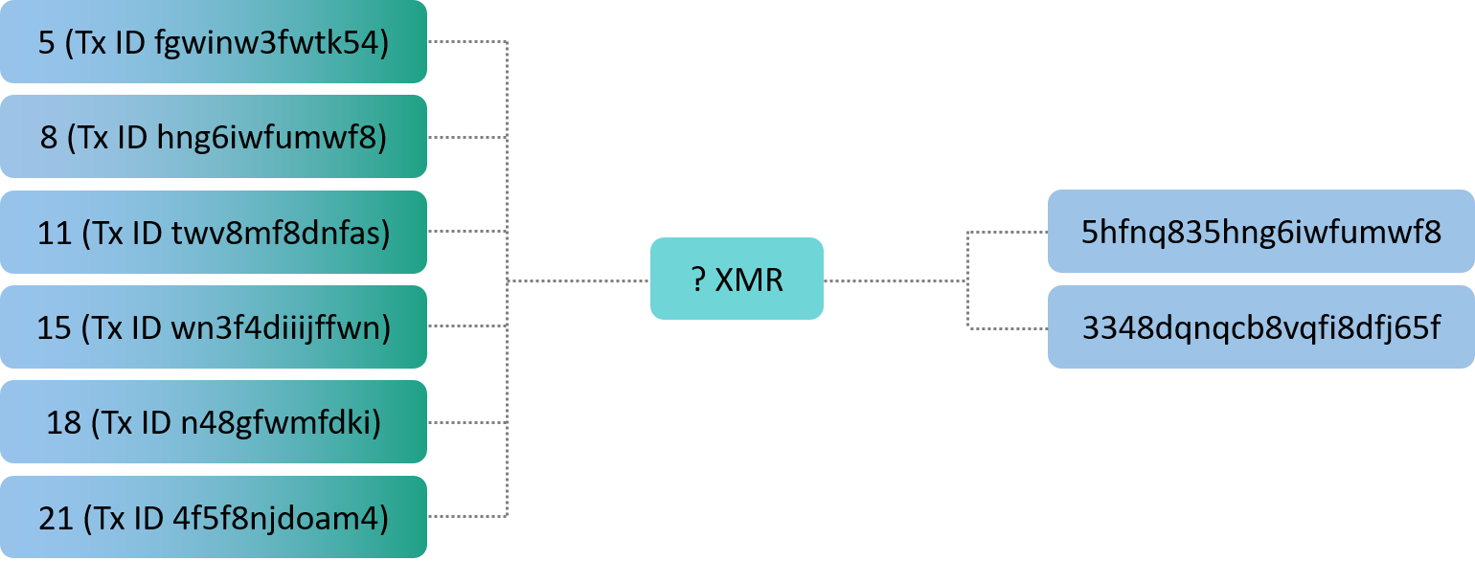
Things Get Complicated Quickly

Slide 21


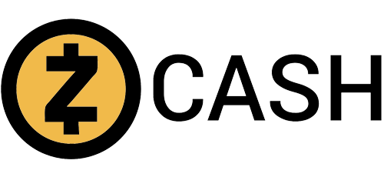
Mandatory Privacy Matters
Total transactions in the past month
206,947
~200,000
~350,000
% of transactions using privacy features
100%
<1%¹
<10%/<0.5%
Number of private transactions
206,947
<2,000
~35,000/~1,750
Notes:
¹https://dashpay.atlassian.net/wiki/spaces/OC/pages/79986710/Messaging+Framework+for+Dash

Slide 22
Regulatory Compliance and Transparency
(with the View Key)
Transparency
Selected Parties
Charities
Parents
A view key is used to reveal all transactions for a Monero account, or just the key for a single transaction
View keys can be given to selected parties, or can be made public
By publishing their view key, charities can invite easy public oversight
Children can be given their own accounts, and parents can monitor their spending
Adapted from Riccardo Spagni’s Presentation
Notes:
Monero can be optionally transparent if the user wants it to be, while only revealing this information to the intended recipient, not the whole world. The Monero project uses this method, publishing the view key with the address on the official website. Now, people can see the amount that comes in from donations.

Slide 23
A Brief History
Feb Critical Vulnerability Patched
March All Tx Private
Apr Launched
Dec GUI Beta 1
Sept Hardfork
Sept Attacked
Jan MRL-0004
Apr Hardfork
Apr Hardfork
2015
2016
Jan RingCT
2014
2017
Adapted from Scott Anecito’s Presentation

Slide 24
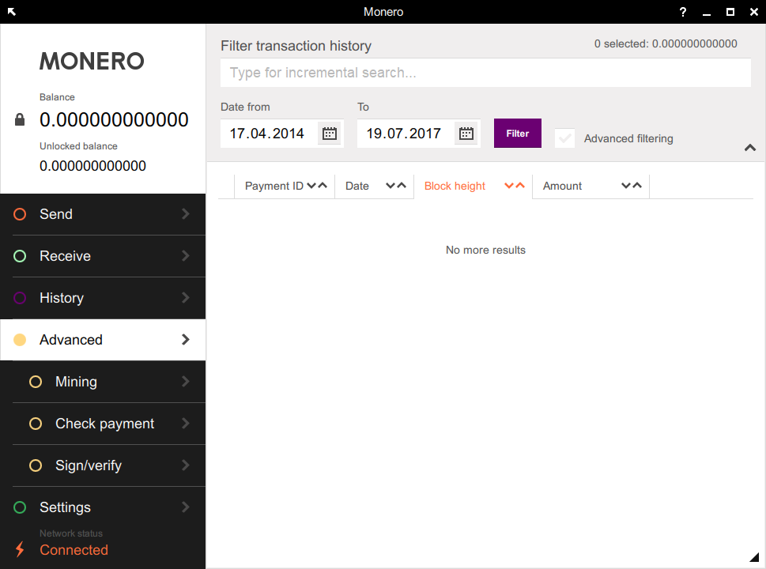
The Infamous GUI
Notes:
This is what the official GUI currently looks like. It is available on a variety of platforms.

Slide 25
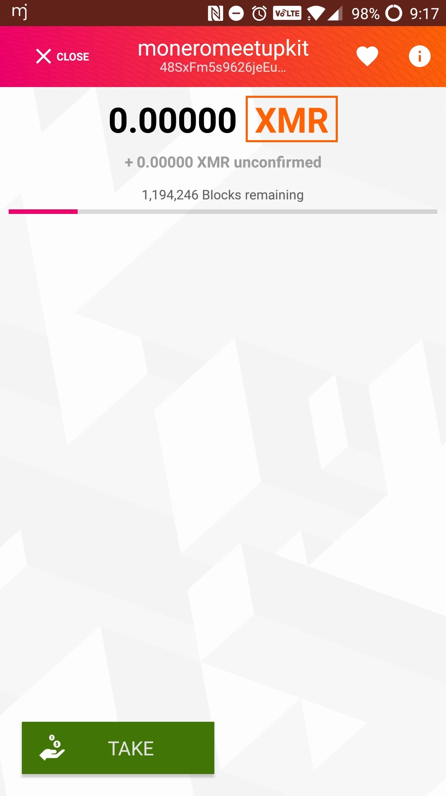
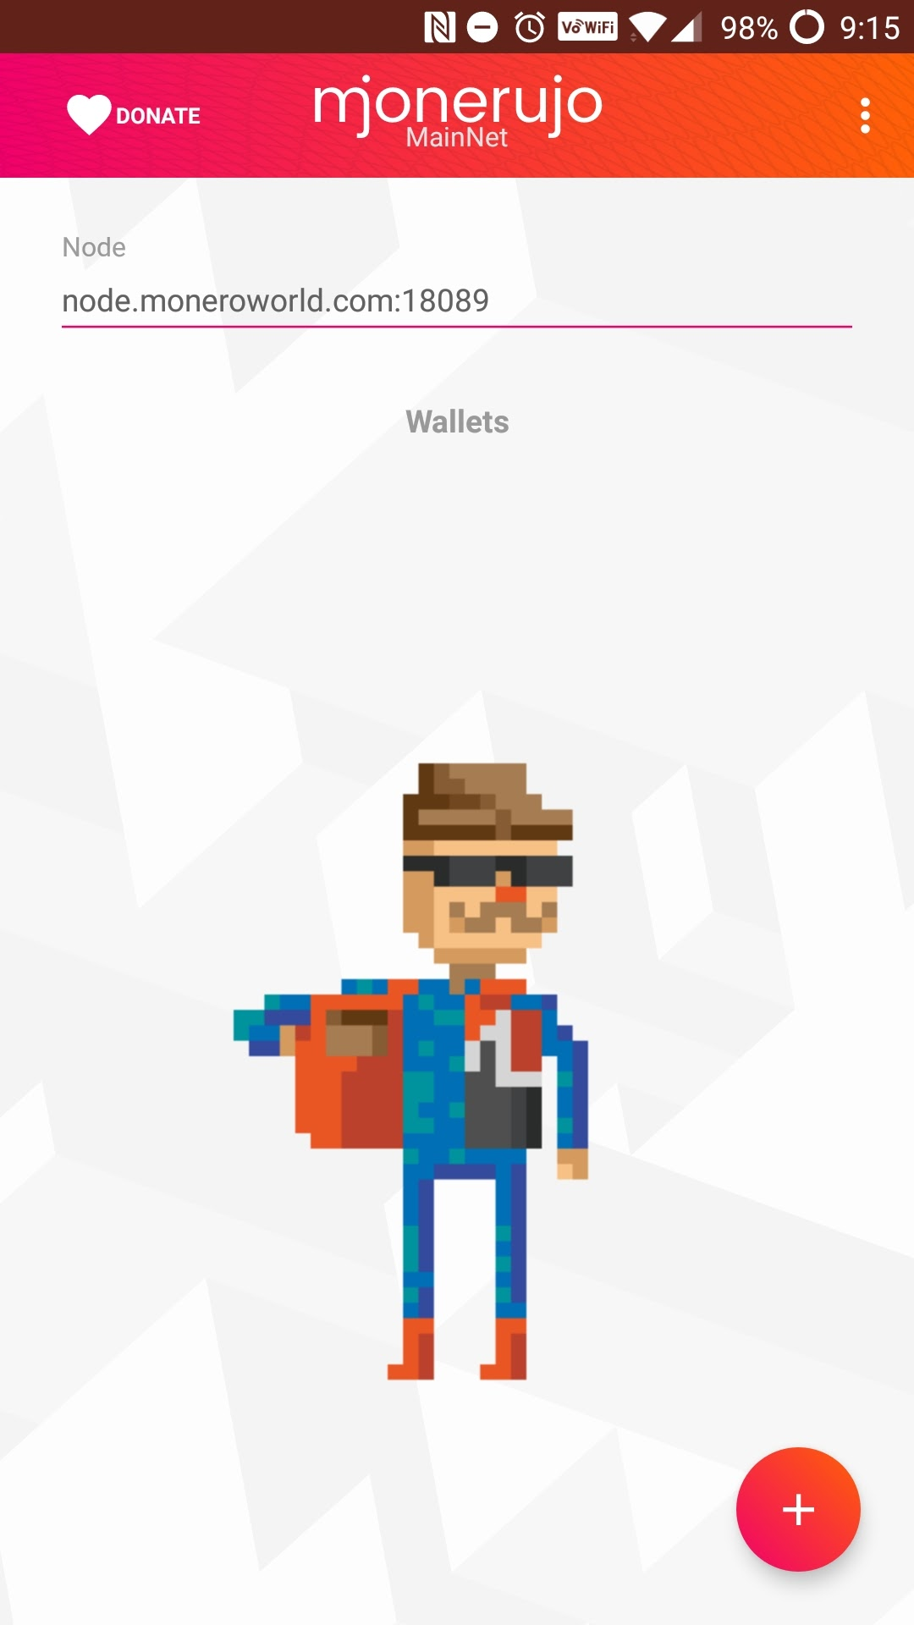
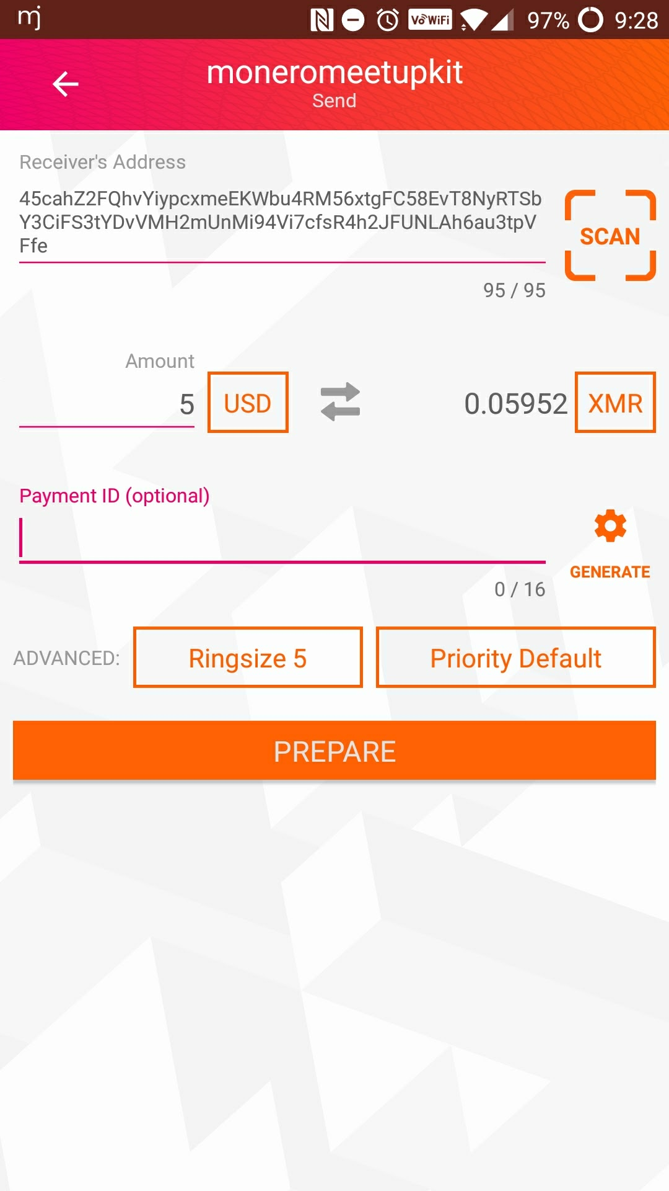
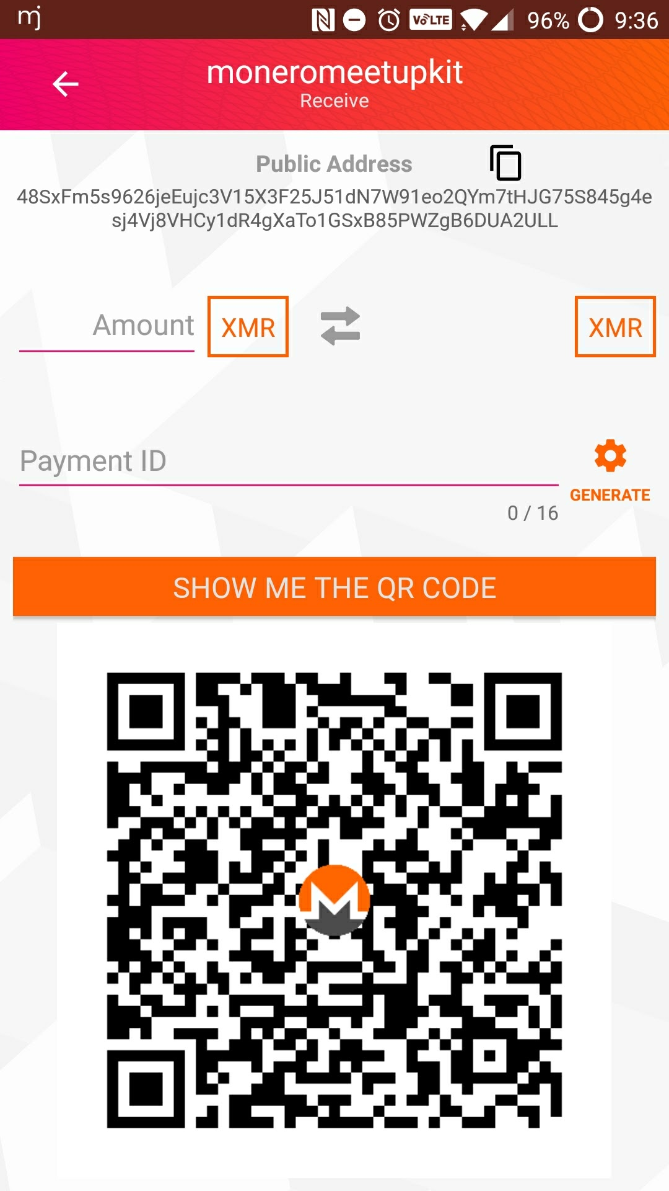
Monerujo Android Wallet

Slide 26
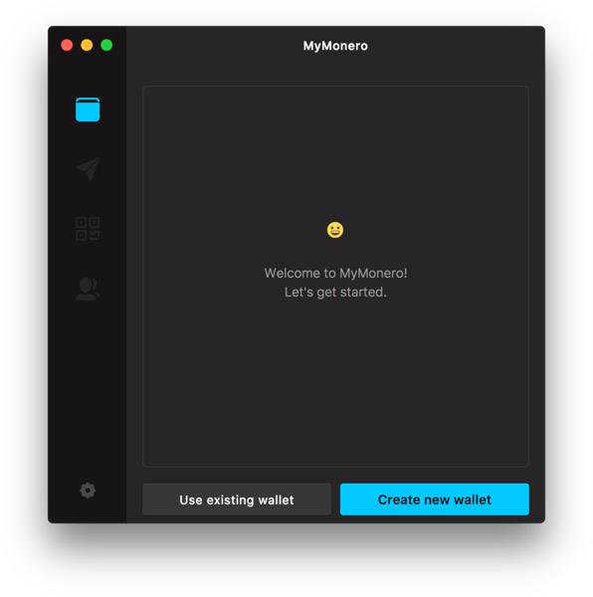
MyMonero Lightweight Wallet
Notes:
This is what the upcoming MyMonero open-source lightweight wallet will look like. It will allow users of Monero to connect to the network in a more sustainable way if they do not wish to run a full node.

Slide 27
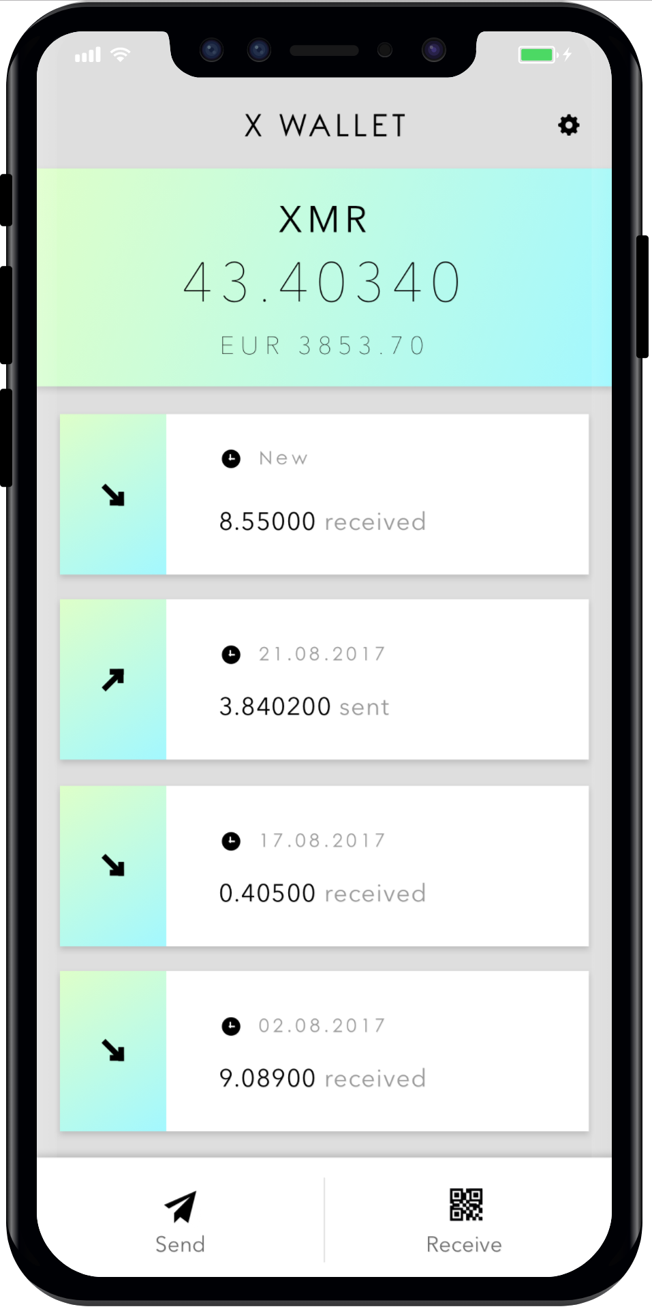
X Wallet iOS Wallet

Slide 28

What’s Next? Addressing Transaction Size
~250B
~13.2kB
with single-output bulletproofs (~2.5kB)
ɱ
with multiple-output bulletproofs (~2.2kB)
Lower Fees
(80-90%)
Faster
Verification Time

Slide 29
What’s Next? Better Untraceability
Current Ringsize 5
RTRS Ringsize 32

Slide 30
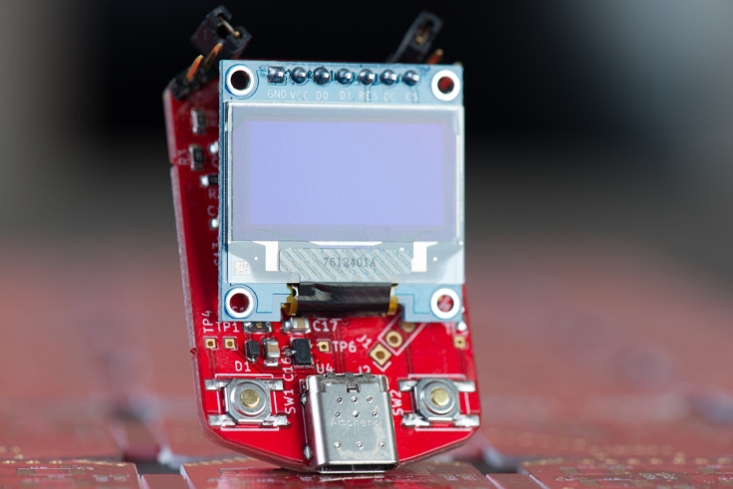
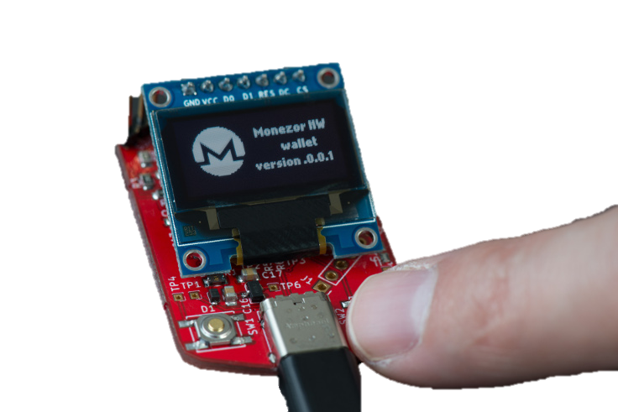
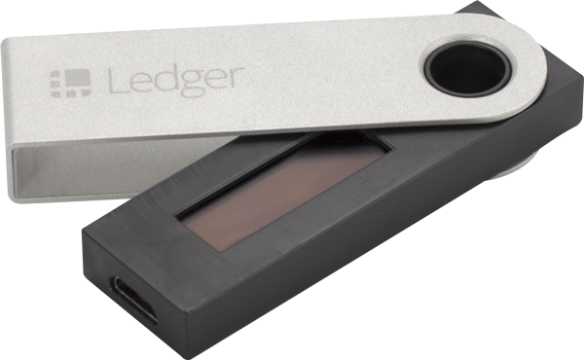
What’s Next? Hardware Wallets

Slide 31
What’s Next? Side Chains
Older
Newer
BLOCK
LIGHTNING NETWORK
MIMBLE WIMBLE
zkSNARK
TumbleBit

Slide 32
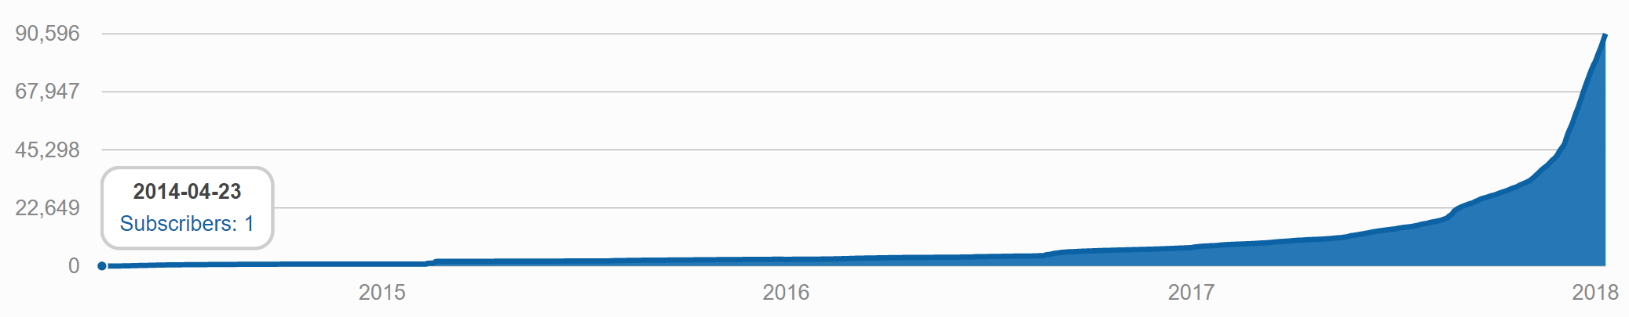
Community Growth

Slide 33
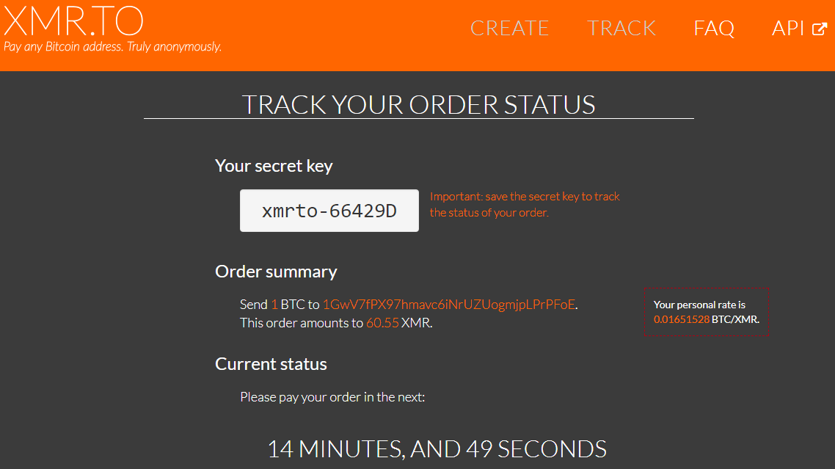
XMR.TO – Pay Bitcoin Addresses with Monero

Slide 34
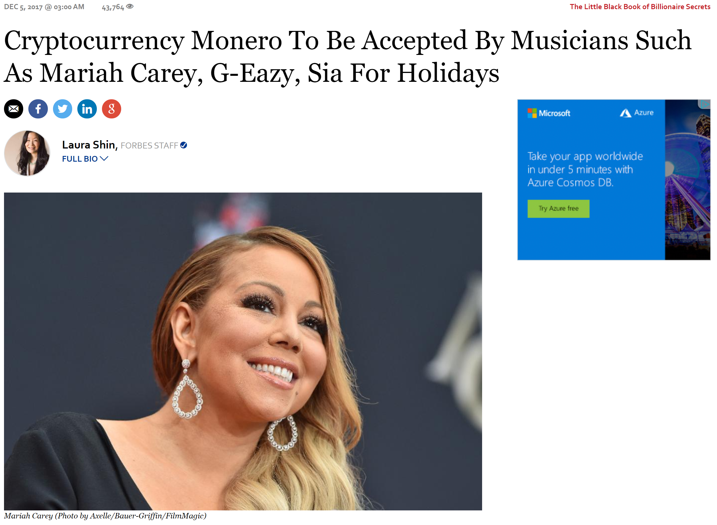
…and you can buy stuff from Mariah Carey

Slide 35
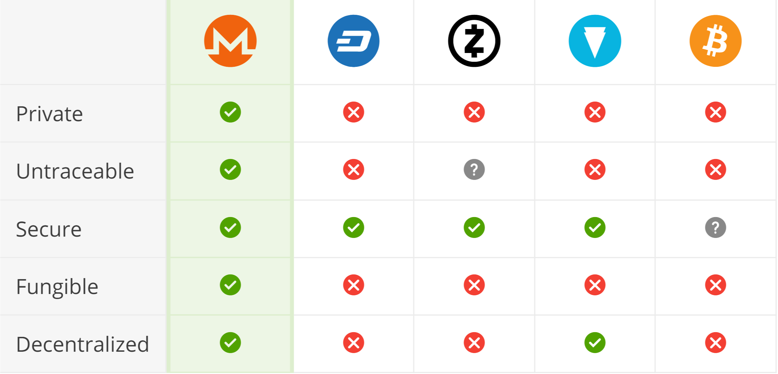

Comparing Privacy Coins

Slide 36

Zcash Transaction Types
x
Fully-shielded
Partially-shielded
Transparent
Sending from one z-address to another z-address
Sender, receiver, and amount hidden with zero-knowledge proofs
<0.5% of transactions in the past month
These theoretically provide greater untraceability than Monero
Sending from one z-address to a t-address or vice versa
Sender OR receiver hidden
Amount visible
<10% of transactions in the past month
Sending from one t-address to another t-address
Sender, receiver, and amount visible, just like Bitcoin
>90% of transactions in the past month
https://explorer.zcha.in/statistics/usage

Slide 37
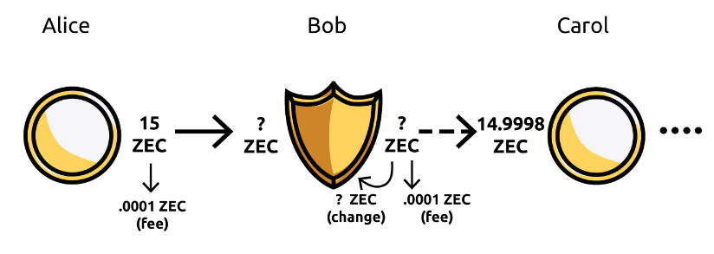
Zcash “Round Trip” Transactions
31.5% of all transactions that enter the shielded
pool can be traced with strong evidence.
http://jeffq.com/blog/on-the-linkability-of-zcash-transactions/

Slide 38


Thank You!
getmonero.org
/r/Monero
monero.stackexchange.com
justin@ehrenhofer.org

